Slide 1
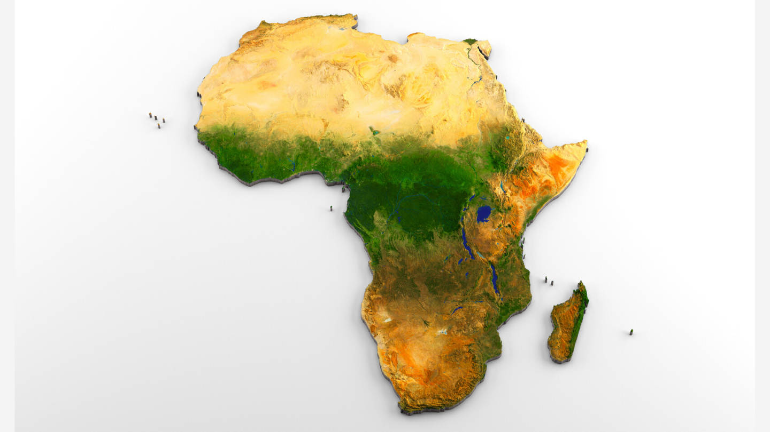
FINANCIAL PARTICIPATION IN KENYA AND UGANDA
ITEC-621 Project Presentation
Team 3: Abhinav Nitesh, Ahmed Malik, Binh Minh An Nguyen, Farhaan S Haque

Slide 2

BUSINESS CASE
Advantages of Financial Participation
Improved tax collection
Enhanced economy monitoring
Streamline Accountability
Boost to E-commerce sector
Efficient financial management services
Improved Banking Services

Slide 3

BUSINESS QUESTION
How to increase the financial participation of the population in Kenya and Uganda?
Who should be the banks' targeted customers?

Slide 4

ANALYTICS GOAL
Prediction goal: Classifying whether a person will open a bank account, based on the attributes of a person.
Interpretation goal: Identifying the different characteristics of customers by the banks for customer targeting?

Slide 5


DATASET OVERVIEW
Total Data point: 8094
Data point for Kenya:6057
Data point for Uganda: 2031
Dependent Variable:Bank Account
We have a total of 10 variables present which are:
Gender
Age
Employment Status
Education Level
Marital Status
Household Size
Location
Relationship with head of household
Cell Phone Access
Country

Slide 6
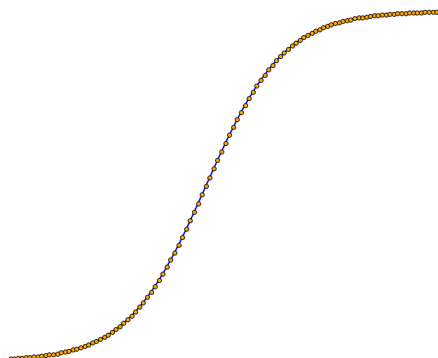
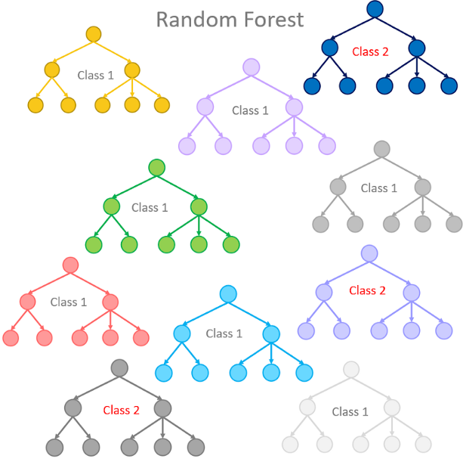
MODEL METHODS AND SPECIFICATIONS
Three Model Methods
1. Logistic Regression
2. Random Forest
3. Boosted Trees
Two Model Specifications
Model A - Full model
Outcome: Bank Account
Predictors: Country+Location Type+Cellphone Access+Household Size+Relationship with Head+ Marital Status + Education Level+Job Type+Age+Gender
Model B - Reduced model without the Household Size
Outcome: Bank Account
Predictors: Country+Location Type+Cellphone Access+Relationship with Head+ Marital Status + Education Level+Job Type+Age+Gender

Slide 7
LOGISTIC REGRESSION
Model A - Full Model
Deviance R.sq: 0.2927
Condition Index: 49.09
Model B - Reduced model without household_size
Deviance R.sq: 0.2922
Condition Index: 46.58
Reference Level: Self-employed
 | Log-Odd | Odds | Probs
Farming & Fishing | -0.359 | 0.699 | 41.1%
No Income | -0.903 | 0.405 | 28.8%
Informally Employed / Remittance Dependent | -0.897 | 0.408 | 29.0%

Slide 8
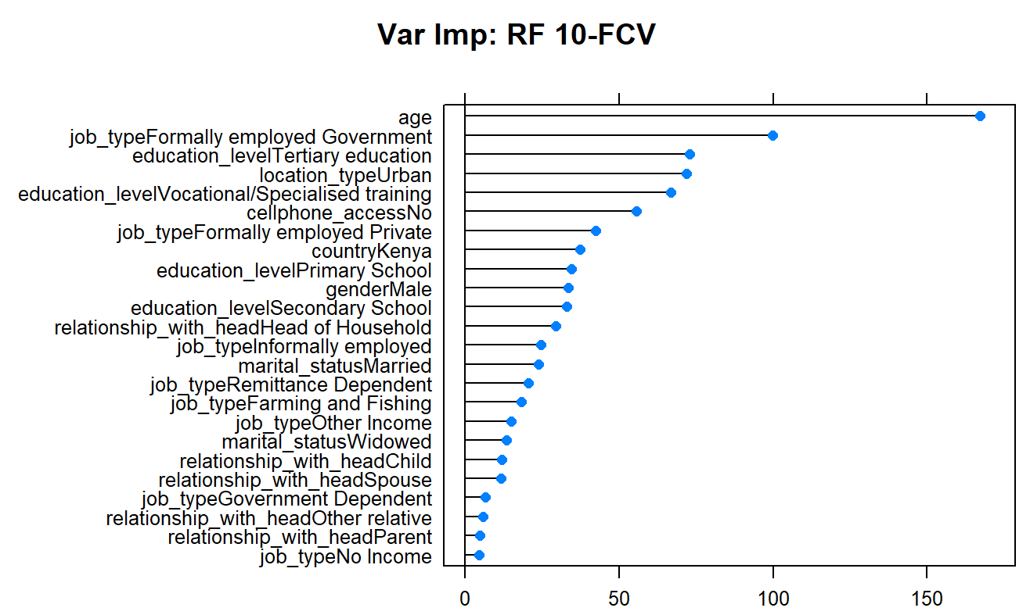
RANDOM FOREST
Top Variables
Age
Government jobs
Post-Secondary education
Location: Urban
Mobile access
Country: Kenya

Slide 9
RANDOM FOREST
Threshold | Accuracy | Error Rate | Sensitivity | Specificity | False Positive
30% | 83.1% | 16.9% | 53.4% | 90.9% | 9.1%
50% | 84.1% | 15.9% | 43.3% | 94.9% | 5.1%
70% | 83.9% | 16.1% | 32.3% | 97.4% | 2.6%
 | Actual |  | Total
Pred. | Yes | No
1 | 288 | 58 | 346
0 | 216 | 1867 | 2083
Total | 504 | 1925 | 2429
Threshold = 50%
M = 5

Slide 10
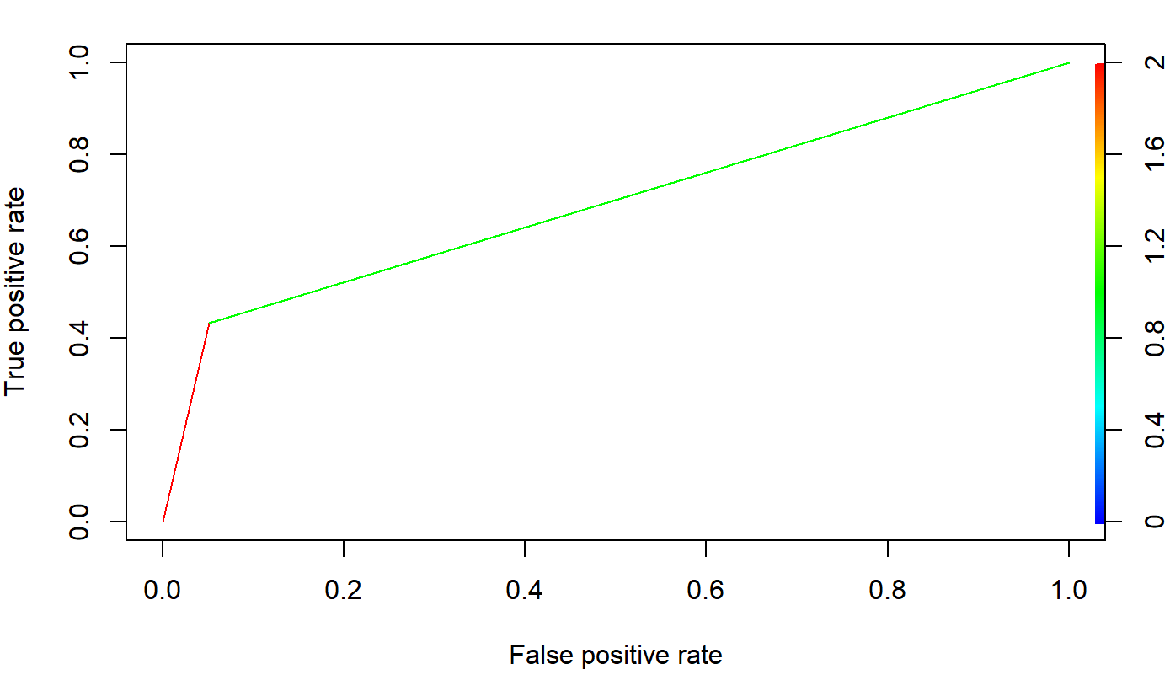
RANDOM FOREST
Threshold = 50%
Area under the ROCR curve is 0.691

Slide 11
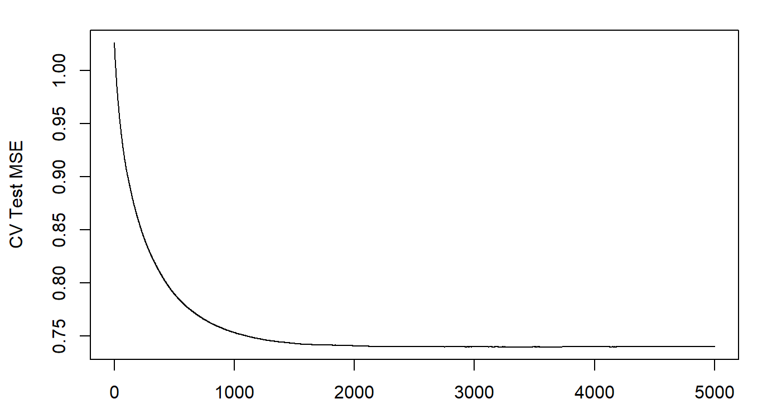
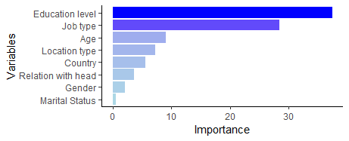
BOOSTED TREES
3455 Trees
MSE = 0.7396

Slide 12
BOOSTED TREES
Threshold | Accuracy | Error Rate | Sensitivity | Specificity | False Positive
30% | 81.6% | 18.4% | 66.1% | 85.7% | 14.3%
50% | 84.4% | 15.6% | 44.8% | 94.8% | 5.2%
70% | 83.4% | 16.6% | 26.0% | 98.5% | 1.5%
 | Actual |  | Total
Pred. | Yes | No
1 | 226 | 101 | 327
0 | 278 | 1824 | 2102
Total | 504 | 1925 | 2429
Threshold = 50%

Slide 13
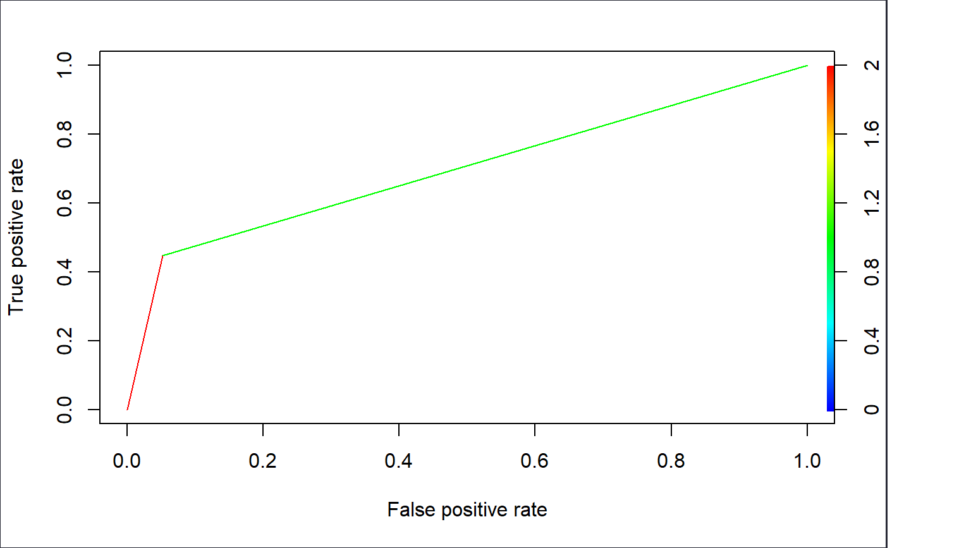
BOOSTED TREES
Threshold = 50%
Area under the ROCR curve is 0.698

Slide 14
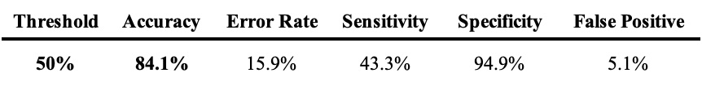
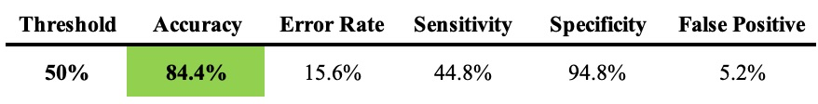
MODEL SELECTION
Random Forest
Boosted Tree
Area = 0.691
Area = 0.698

Slide 15
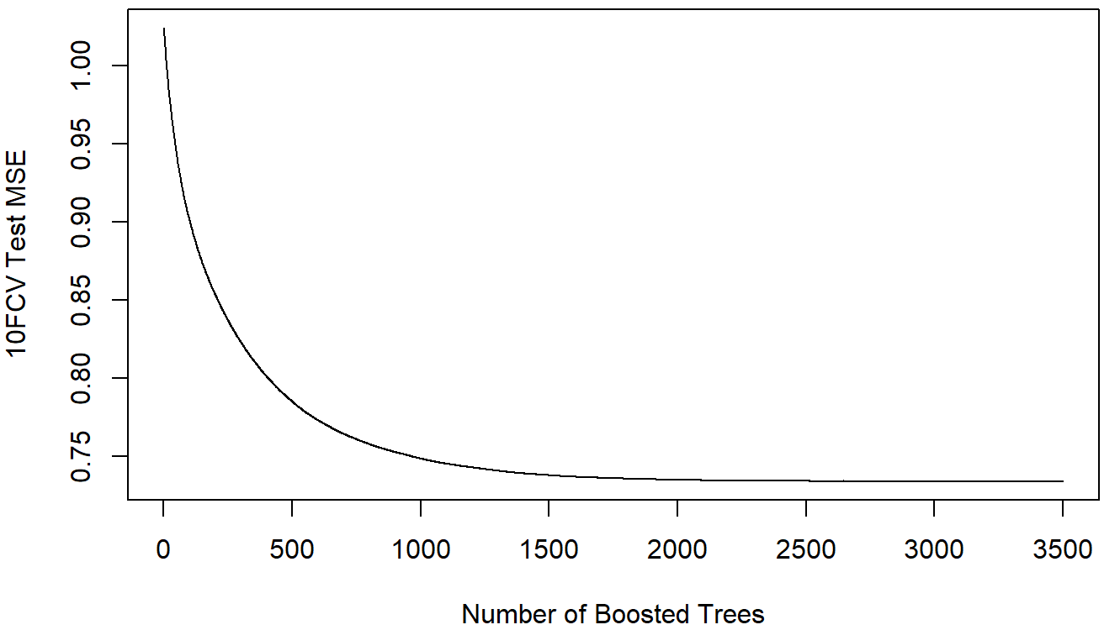
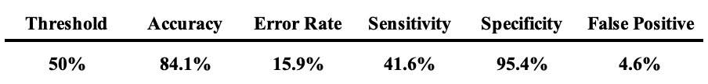
MODEL REVALIDATION
 | Actual |  | Total
Pred. | Yes | No
1 | 705 | 294 | 999
0 | 990 | 6105 | 7095
Total | 1695 | 6399 | 8094
2898 Trees
MSE = 0.7336

Slide 16
CONCLUSION
Government of Uganda and Kenya:
Have financial education programs in place targeting income groups that lack financial understanding
Help with the goal of financial participation
Banks
Focus on the key attributes/predictors to help banks identify which customers will open up a bank account
Use the model to better anticipate who is going to convert into a customer based on customer characteristics
Know which campaigns to push to what demographic of the population
Hence addressing the concern of financial participation

Slide 17

THANK YOU!

Slide 18
country | Country of person either Uganda or Kenya | Categorical variable
gender | Male or Female | Categorical variable
age | Age of a person | Quantitative Variable
location_type | The type of area a person is living in Urban. Rural, etc. | Categorical Variable
relationship_with_head | Relationship with the head of the household | Categorical Variable
household_size | How many people live in a household | Quantitative Variable
marital_status | Marriage status of the person single, widowed, wtc. | Categorical Variable
education_level | The education level of the person | Categorical Variable
job_type | The job industry a person is working in | Categorical Variable
cellphone_access | what channel user came from | Categorical Variable
bank_acct | Person has a bank account or not | Binary variable
Data Understanding

